Slide 1
Blockchain - Distributed Ledger Technology for Digital Trust
Rushikesh Ghatpande, Siddharth Heggadahalli, Abhash Jain

Slide 2
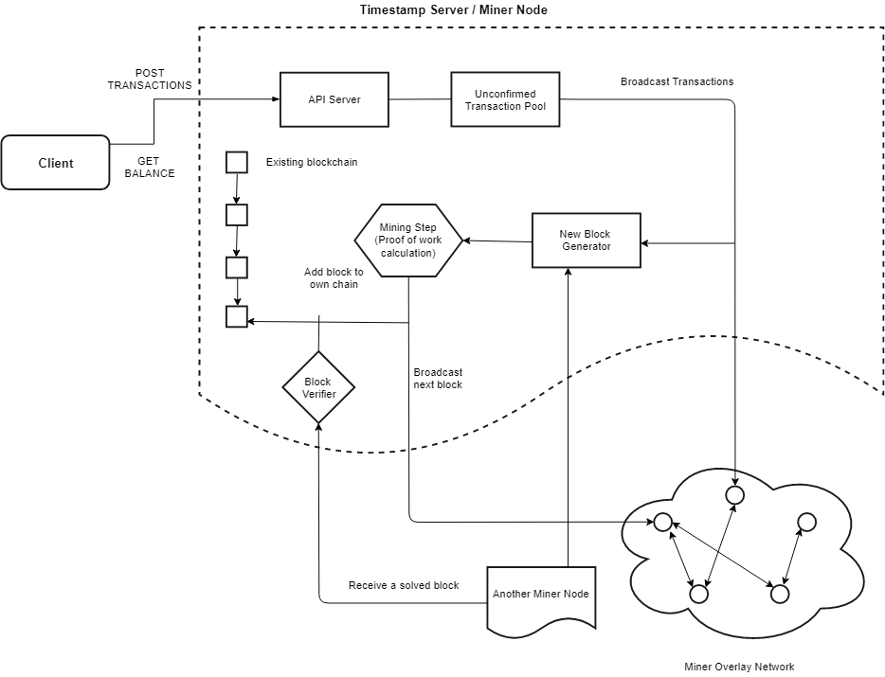
Notes:
Wha

Slide 3
PROGRESS REPORT !!!

Slide 4
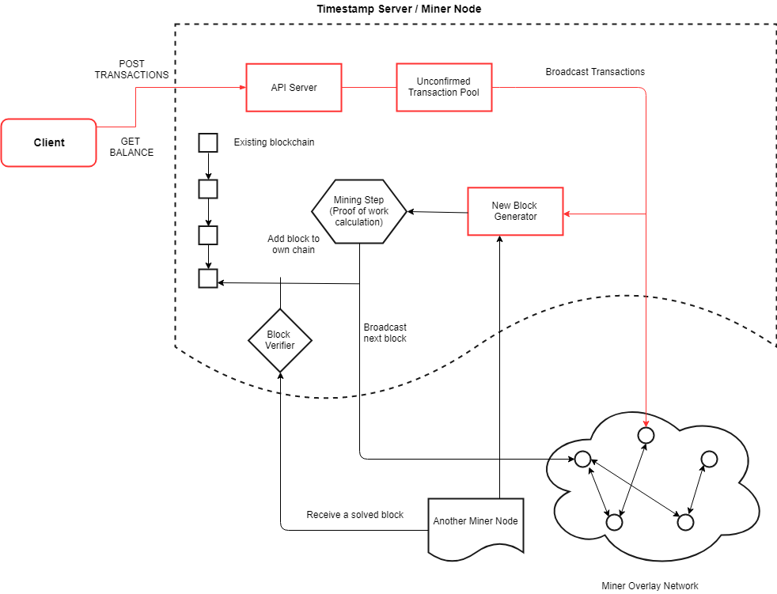
Notes:
Wha

Slide 5
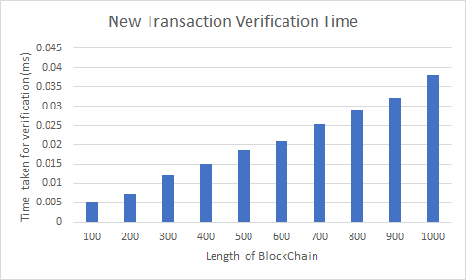
New Transaction Verification
Notes:
Time taken for verification of transaction is proportional to the length of the blockchain. As the length of the blockchain increases, the verification time of each transaction also increases.
More people use it, longer the chain and also more number of new transactions to be verified.
To avoid this scenario we must find a solution to reduce the time taken for verifying the block chain.
Decentralized Consensus:
1.Client send transaction to a node and these transaction are broadcasted.
2. Each node will collect pending transaction into a block.
3. Each node will work to find a POW for it’s block.
4. When a new node finds a pow, it broadcast this to all nodes and append it to its own replica
5. Node express their acceptance of the block by adding it to blockchain and working on creating next block.
Double spending Problem:
General approach is to introduce a third party to verify this. But Blockchain don’t have any other authority.
Same amount spent twice:
Alice have some money which he used to buy something from merchant Bob. Bob see this transaction and assume he had received money and ship the item.
Later, allice use the same money to buy something else if she is the one who creates the transaction
Blockchain avoid this scenario by confirming that once new block added after this transaction means most of the node had accepted this and this is a legitimate transaction.
Single node can’t hack Blockchain network as he need more computer power than combine honest node because he has to surpass the new block creation by honest nodes.
Always longest chain is considered as majority deciosion. If someone see a longer chain than it validates all Tx and merge its chain with this new received chain.

Slide 6
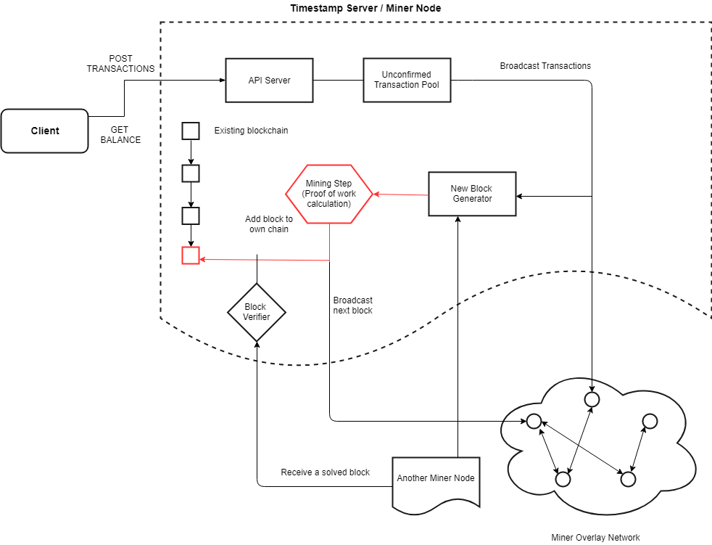
Notes:
Wha

Slide 7
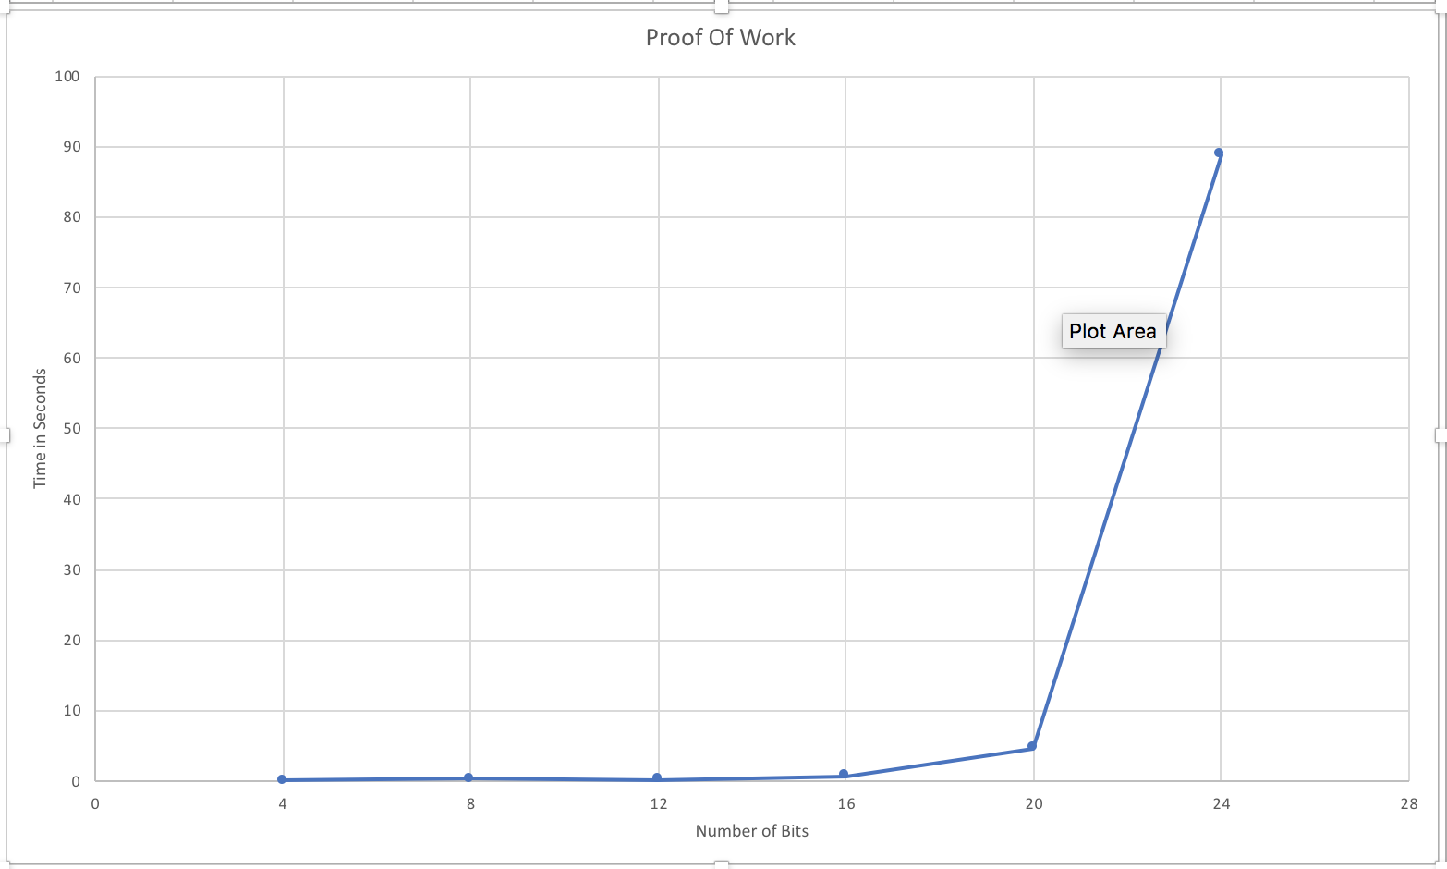
Proof of Work Results
Notes:
Decentralized Consensus:
1.Client send transaction to a node and these transaction are broadcasted.
2. Each node will collect pending transaction into a block.
3. Each node will work to find a POW for it’s block.
4. When a new node finds a pow, it broadcast this to all nodes and append it to its own replica
5. Node express their acceptance of the block by adding it to blockchain and working on creating next block.
Double spending Problem:
General approach is to introduce a third party to verify this. But Blockchain don’t have any other authority.
Same amount spent twice:
Alice have some money which he used to buy something from merchant Bob. Bob see this transaction and assume he had received money and ship the item.
Later, allice use the same money to buy something else if she is the one who creates the transaction
Blockchain avoid this scenario by confirming that once new block added after this transaction means most of the node had accepted this and this is a legitimate transaction.
Single node can’t hack Blockchain network as he need more computer power than combine honest node because he has to surpass the new block creation by honest nodes.
Always longest chain is considered as majority deciosion. If someone see a longer chain than it validates all Tx and merge its chain with this new received chain.

Slide 8
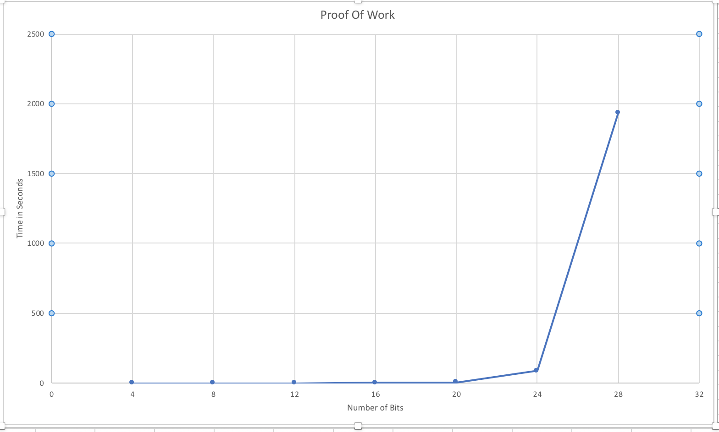
New

Slide 9
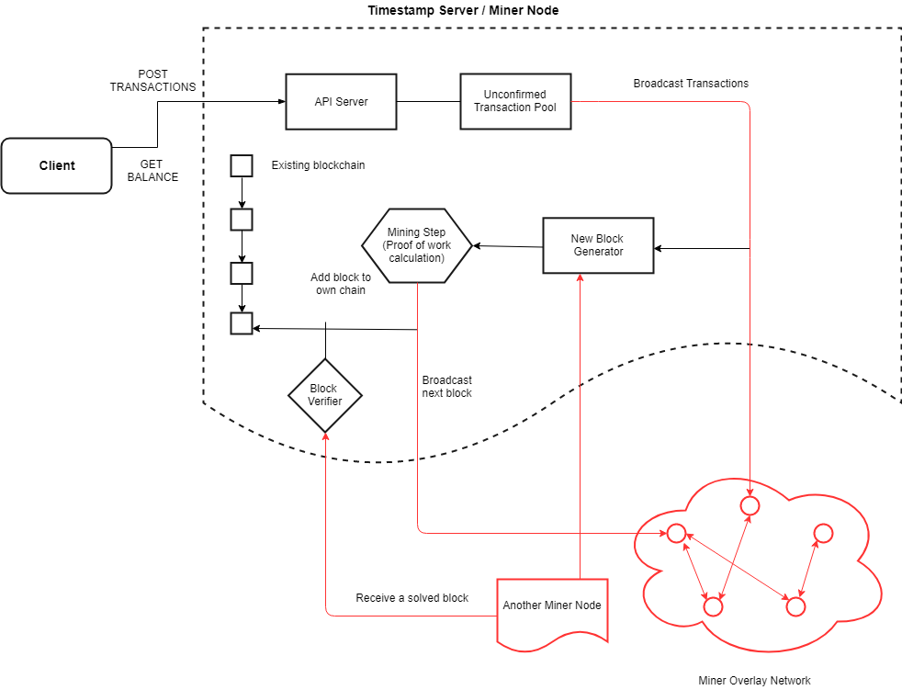
Notes:
Wha

Slide 10
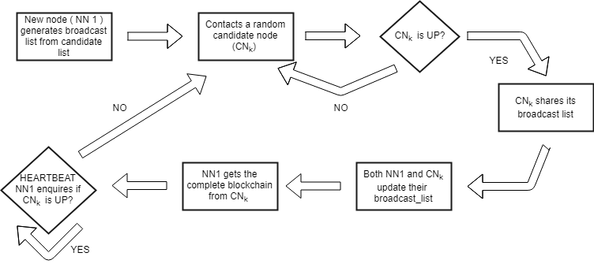
Stabilization Workflow
Notes:
Suppose we have a 3 node cluster, these nodes generate a broadcast list based on candidate list.

Slide 11
Node Arrival Results
Existing Nodes | Nodes Added | Time Taken (in ms)
3 | 1 | 110
4 | 1 | 257
3 | 2 | 311
Notes:
Decentralized Consensus:
1.Client send transaction to a node and these transaction are broadcasted.
2. Each node will collect pending transaction into a block.
3. Each node will work to find a POW for it’s block.
4. When a new node finds a pow, it broadcast this to all nodes and append it to its own replica
5. Node express their acceptance of the block by adding it to blockchain and working on creating next block.
Double spending Problem:
General approach is to introduce a third party to verify this. But Blockchain don’t have any other authority.
Same amount spent twice:
Alice have some money which he used to buy something from merchant Bob. Bob see this transaction and assume he had received money and ship the item.
Later, allice use the same money to buy something else if she is the one who creates the transaction
Blockchain avoid this scenario by confirming that once new block added after this transaction means most of the node had accepted this and this is a legitimate transaction.
Single node can’t hack Blockchain network as he need more computer power than combine honest node because he has to surpass the new block creation by honest nodes.
Always longest chain is considered as majority deciosion. If someone see a longer chain than it validates all Tx and merge its chain with this new received chain.

Slide 12
Technologies
C++11
Pistache REST Framework
Boost
OpenSSL
VCL infrastructure
Notes:
Decentralized Consensus:
1.Client send transaction to a node and these transaction are broadcasted.
2. Each node will collect pending transaction into a block.
3. Each node will work to find a POW for it’s block.
4. When a new node finds a pow, it broadcast this to all nodes and append it to its own replica
5. Node express their acceptance of the block by adding it to blockchain and working on creating next block.
Double spending Problem:
General approach is to introduce a third party to verify this. But Blockchain don’t have any other authority.
Same amount spent twice:
Alice have some money which he used to buy something from merchant Bob. Bob see this transaction and assume he had received money and ship the item.
Later, allice use the same money to buy something else if she is the one who creates the transaction
Blockchain avoid this scenario by confirming that once new block added after this transaction means most of the node had accepted this and this is a legitimate transaction.
Single node can’t hack Blockchain network as he need more computer power than combine honest node because he has to surpass the new block creation by honest nodes.
Always longest chain is considered as majority deciosion. If someone see a longer chain than it validates all Tx and merge its chain with this new received chain.

Slide 13
Future Work
End-to-end integration
Concurrency in Miner Node
Handling forked blockchain
Concurrent node addition and failure
Improvements & experimentation
Notes:
Decentralized Consensus:
1.Client send transaction to a node and these transaction are broadcasted.
2. Each node will collect pending transaction into a block.
3. Each node will work to find a POW for it’s block.
4. When a new node finds a pow, it broadcast this to all nodes and append it to its own replica
5. Node express their acceptance of the block by adding it to blockchain and working on creating next block.
Double spending Problem:
General approach is to introduce a third party to verify this. But Blockchain don’t have any other authority.
Same amount spent twice:
Alice have some money which he used to buy something from merchant Bob. Bob see this transaction and assume he had received money and ship the item.
Later, allice use the same money to buy something else if she is the one who creates the transaction
Blockchain avoid this scenario by confirming that once new block added after this transaction means most of the node had accepted this and this is a legitimate transaction.
Single node can’t hack Blockchain network as he need more computer power than combine honest node because he has to surpass the new block creation by honest nodes.
Always longest chain is considered as majority deciosion. If someone see a longer chain than it validates all Tx and merge its chain with this new received chain.

Slide 14
Improvements
Parallelizing proof-of-work using GPU
Analysis for reaching consensus at different broadcast failure rate
Notes:
Decentralized Consensus:
1.Client send transaction to a node and these transaction are broadcasted.
2. Each node will collect pending transaction into a block.
3. Each node will work to find a POW for it’s block.
4. When a new node finds a pow, it broadcast this to all nodes and append it to its own replica
5. Node express their acceptance of the block by adding it to blockchain and working on creating next block.
Double spending Problem:
General approach is to introduce a third party to verify this. But Blockchain don’t have any other authority.
Same amount spent twice:
Alice have some money which he used to buy something from merchant Bob. Bob see this transaction and assume he had received money and ship the item.
Later, allice use the same money to buy something else if she is the one who creates the transaction
Blockchain avoid this scenario by confirming that once new block added after this transaction means most of the node had accepted this and this is a legitimate transaction.
Single node can’t hack Blockchain network as he need more computer power than combine honest node because he has to surpass the new block creation by honest nodes.
Always longest chain is considered as majority deciosion. If someone see a longer chain than it validates all Tx and merge its chain with this new received chain.

Slide 15
Problems
Thread-safety in Miner node
Serialization issues with very large objects (complete blockchain)
Providing persistence for blockchain
Notes:
Decentralized Consensus:
1.Client send transaction to a node and these transaction are broadcasted.
2. Each node will collect pending transaction into a block.
3. Each node will work to find a POW for it’s block.
4. When a new node finds a pow, it broadcast this to all nodes and append it to its own replica
5. Node express their acceptance of the block by adding it to blockchain and working on creating next block.
Double spending Problem:
General approach is to introduce a third party to verify this. But Blockchain don’t have any other authority.
Same amount spent twice:
Alice have some money which he used to buy something from merchant Bob. Bob see this transaction and assume he had received money and ship the item.
Later, allice use the same money to buy something else if she is the one who creates the transaction
Blockchain avoid this scenario by confirming that once new block added after this transaction means most of the node had accepted this and this is a legitimate transaction.
Single node can’t hack Blockchain network as he need more computer power than combine honest node because he has to surpass the new block creation by honest nodes.
Always longest chain is considered as majority deciosion. If someone see a longer chain than it validates all Tx and merge its chain with this new received chain.

Slide 16

Questions?!?

Slide 17
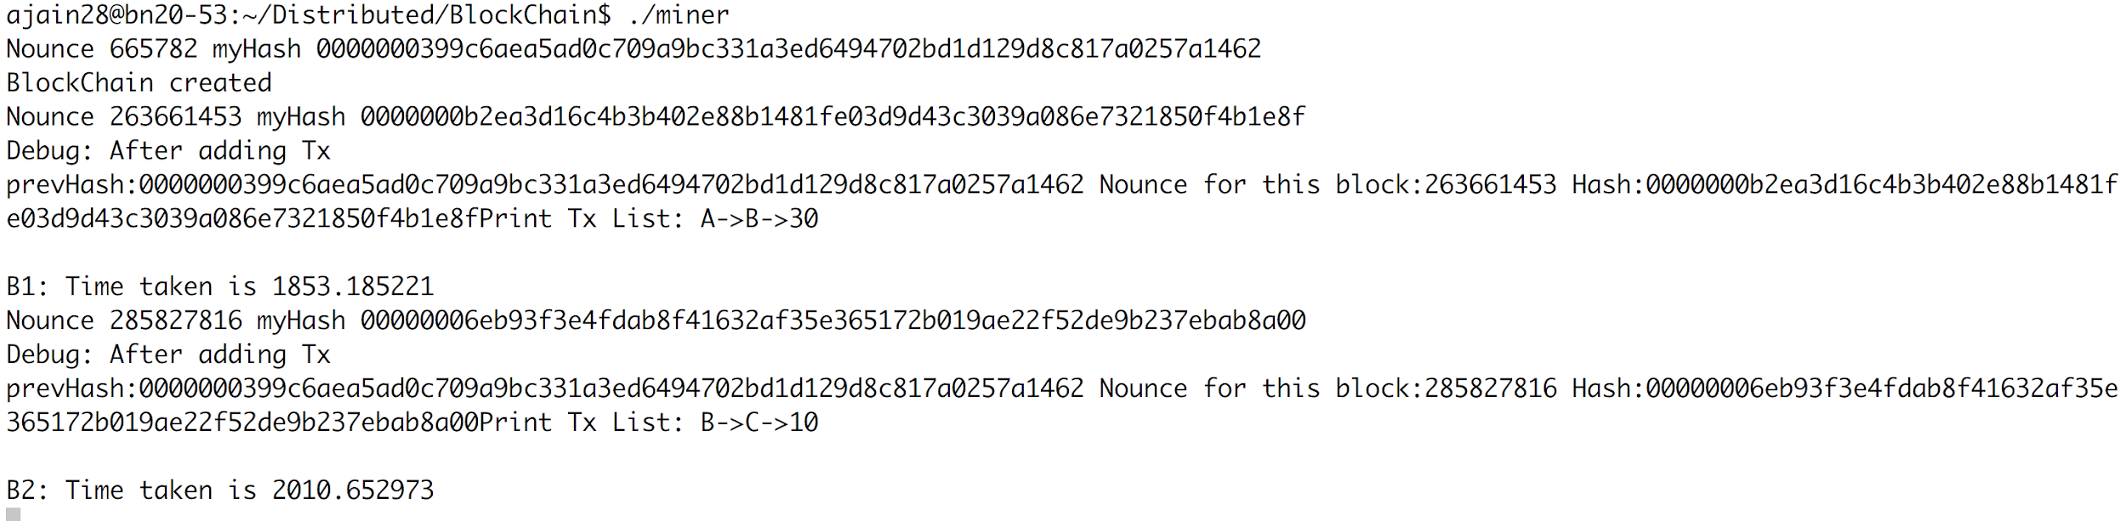
Timestamp Server (Backup Slides)

Slide 18
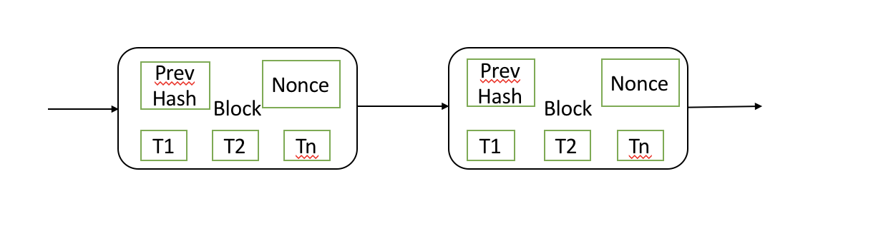
Proof of Work (pow)- Backup-slide
•Takes care of leading zero’s in hash which was published by Timestamp server

